Slide 1
Ion University: Workflow Ion OT2 w/ S5™ & S5xl™
January 2017
Robert David, Staff Field Applications Specialist

Slide 2
Ion Torrent Workflow
Library
Preparation
Template Preparation*
Sequencing*
Data Analysis
Notes:
Set expectations of the class:
There are several parts of the Ion workflow. The important phases are broken u here. The parts in blue we will go over in the lab together. This course does not cover the Library Prep portion of the workflow but we do offer several courses which cover this portion of the workflow.

Slide 3

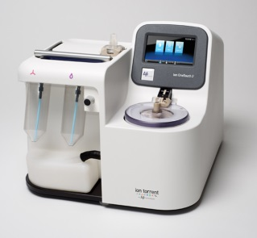
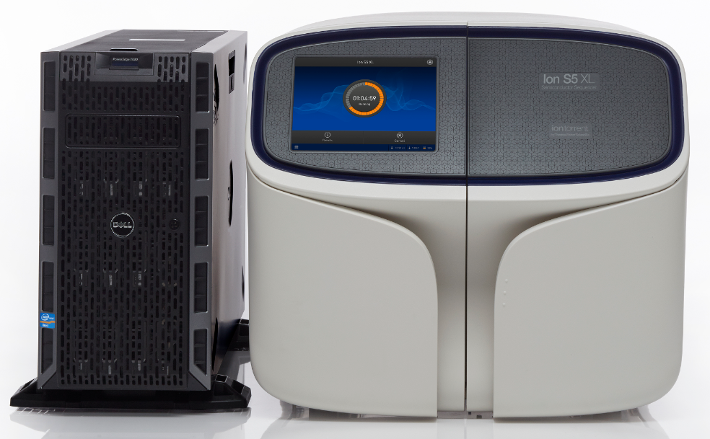
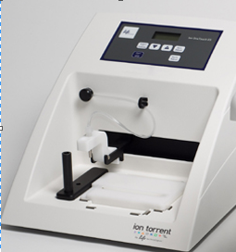
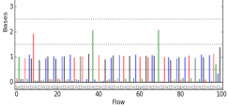
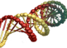
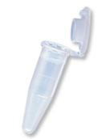
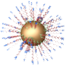

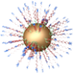
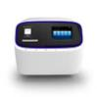
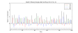
Ion Workflow Overview
A
DNA
B
Compatible Library Prep
C
10
Template Prep
10
Prepare
Library
Clonal
Amplification
Isolate Positive
Ion Sphere™
Particles
Load Chip
and Sequence
D
Data Analysis
Sequencing
E
Compatible Data
Notes:
Ion Torrent Systems, Inc.
3

Slide 4
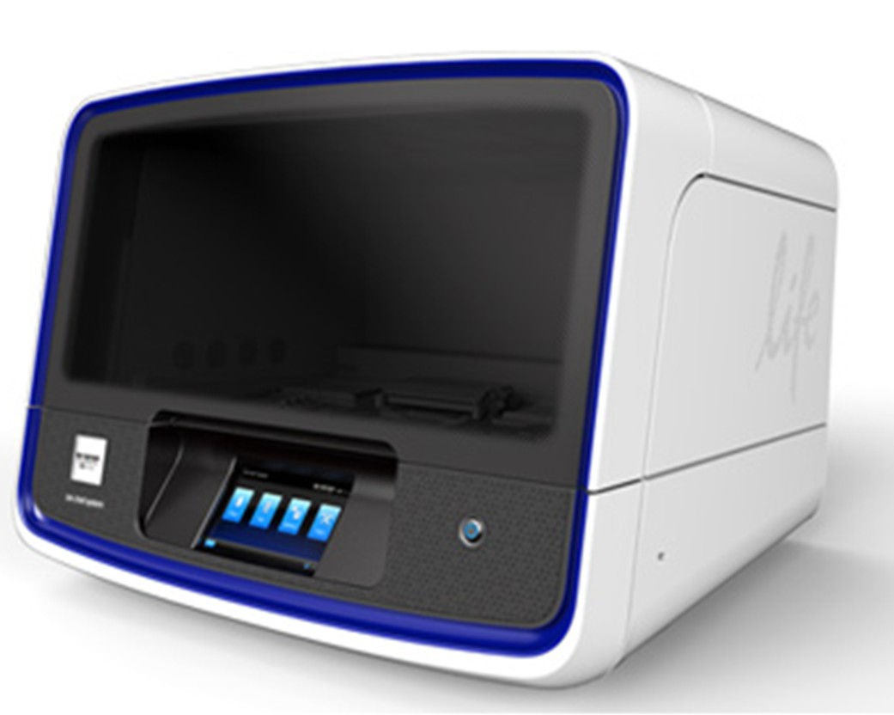
Two options for Template Prep Workflow
Library Preparation
Template Preparation*
Sequencing*
Data Analysis
OneTouch2TM ES
Template Prep Enrichment
Ion Chef TM
Template Prep , Enrichment & Loading

Slide 5
Ion Template Prep: Ion OneTouch™ 2 System

Slide 6
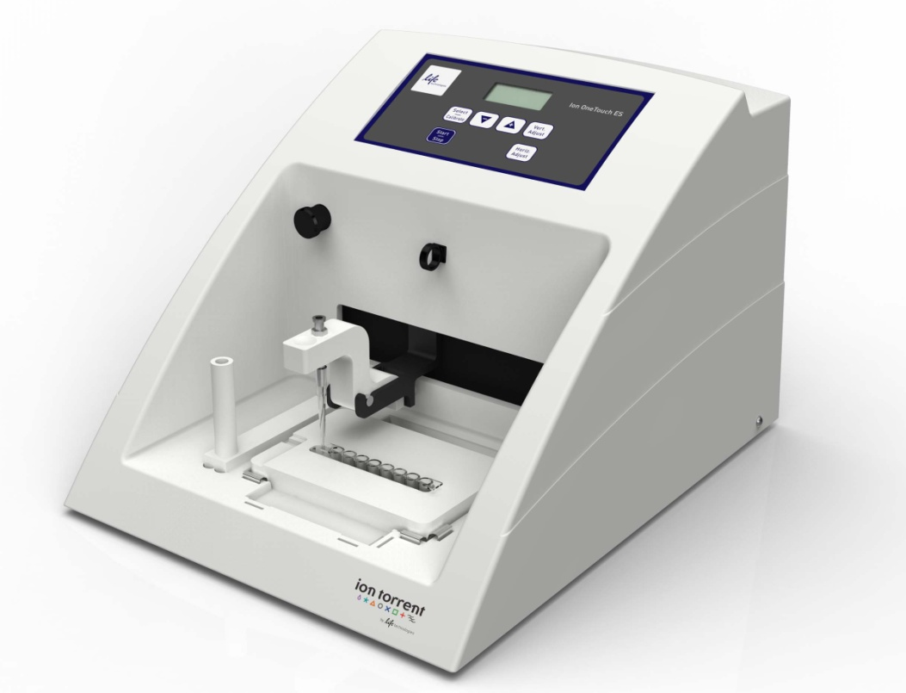
Ion OneTouch™ 2 and ES Systems
Library Preparation
Template Preparation*
Sequencing*
Data Analysis
Ion OneTouch™2 Enrichment System (ES)
Notes:
Easy-to-use, benchtop system that automates Ion’s proven template prep protocol
Minutes of hands-on time, ~6-8 hours total time
Modular design enables template prep of samples in parallel with an Ion PGM™ Sequencer run and quality control of samples pre- and post- enrichment
Perform Ion’s template prep and sequencing workflow in a single working day

Slide 7
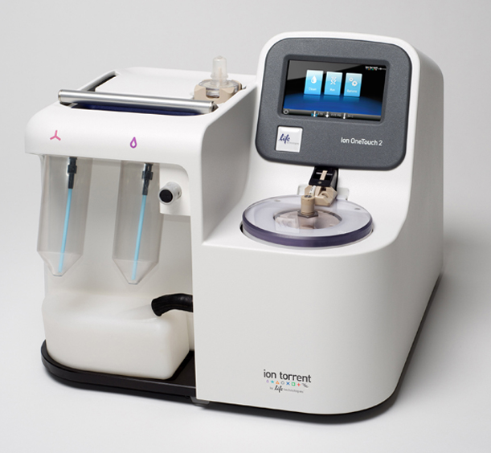
Ion OneTouch™ 2 Instrument Orientation
Reaction Filter
Touchscreen Interface
ISP Recovery Centrifuge
Tube for Ion OneTouch™ Oil
Tube for
Recovery Solution
Waste Container
Minimal Site-Prep, Simple Installation
Notes:
Update firmware via USB drive or ethernet connection
Installation includes one-time instrument initialization

Slide 8
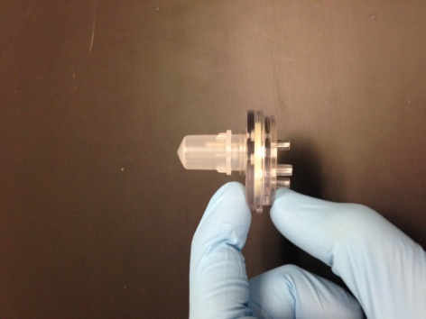
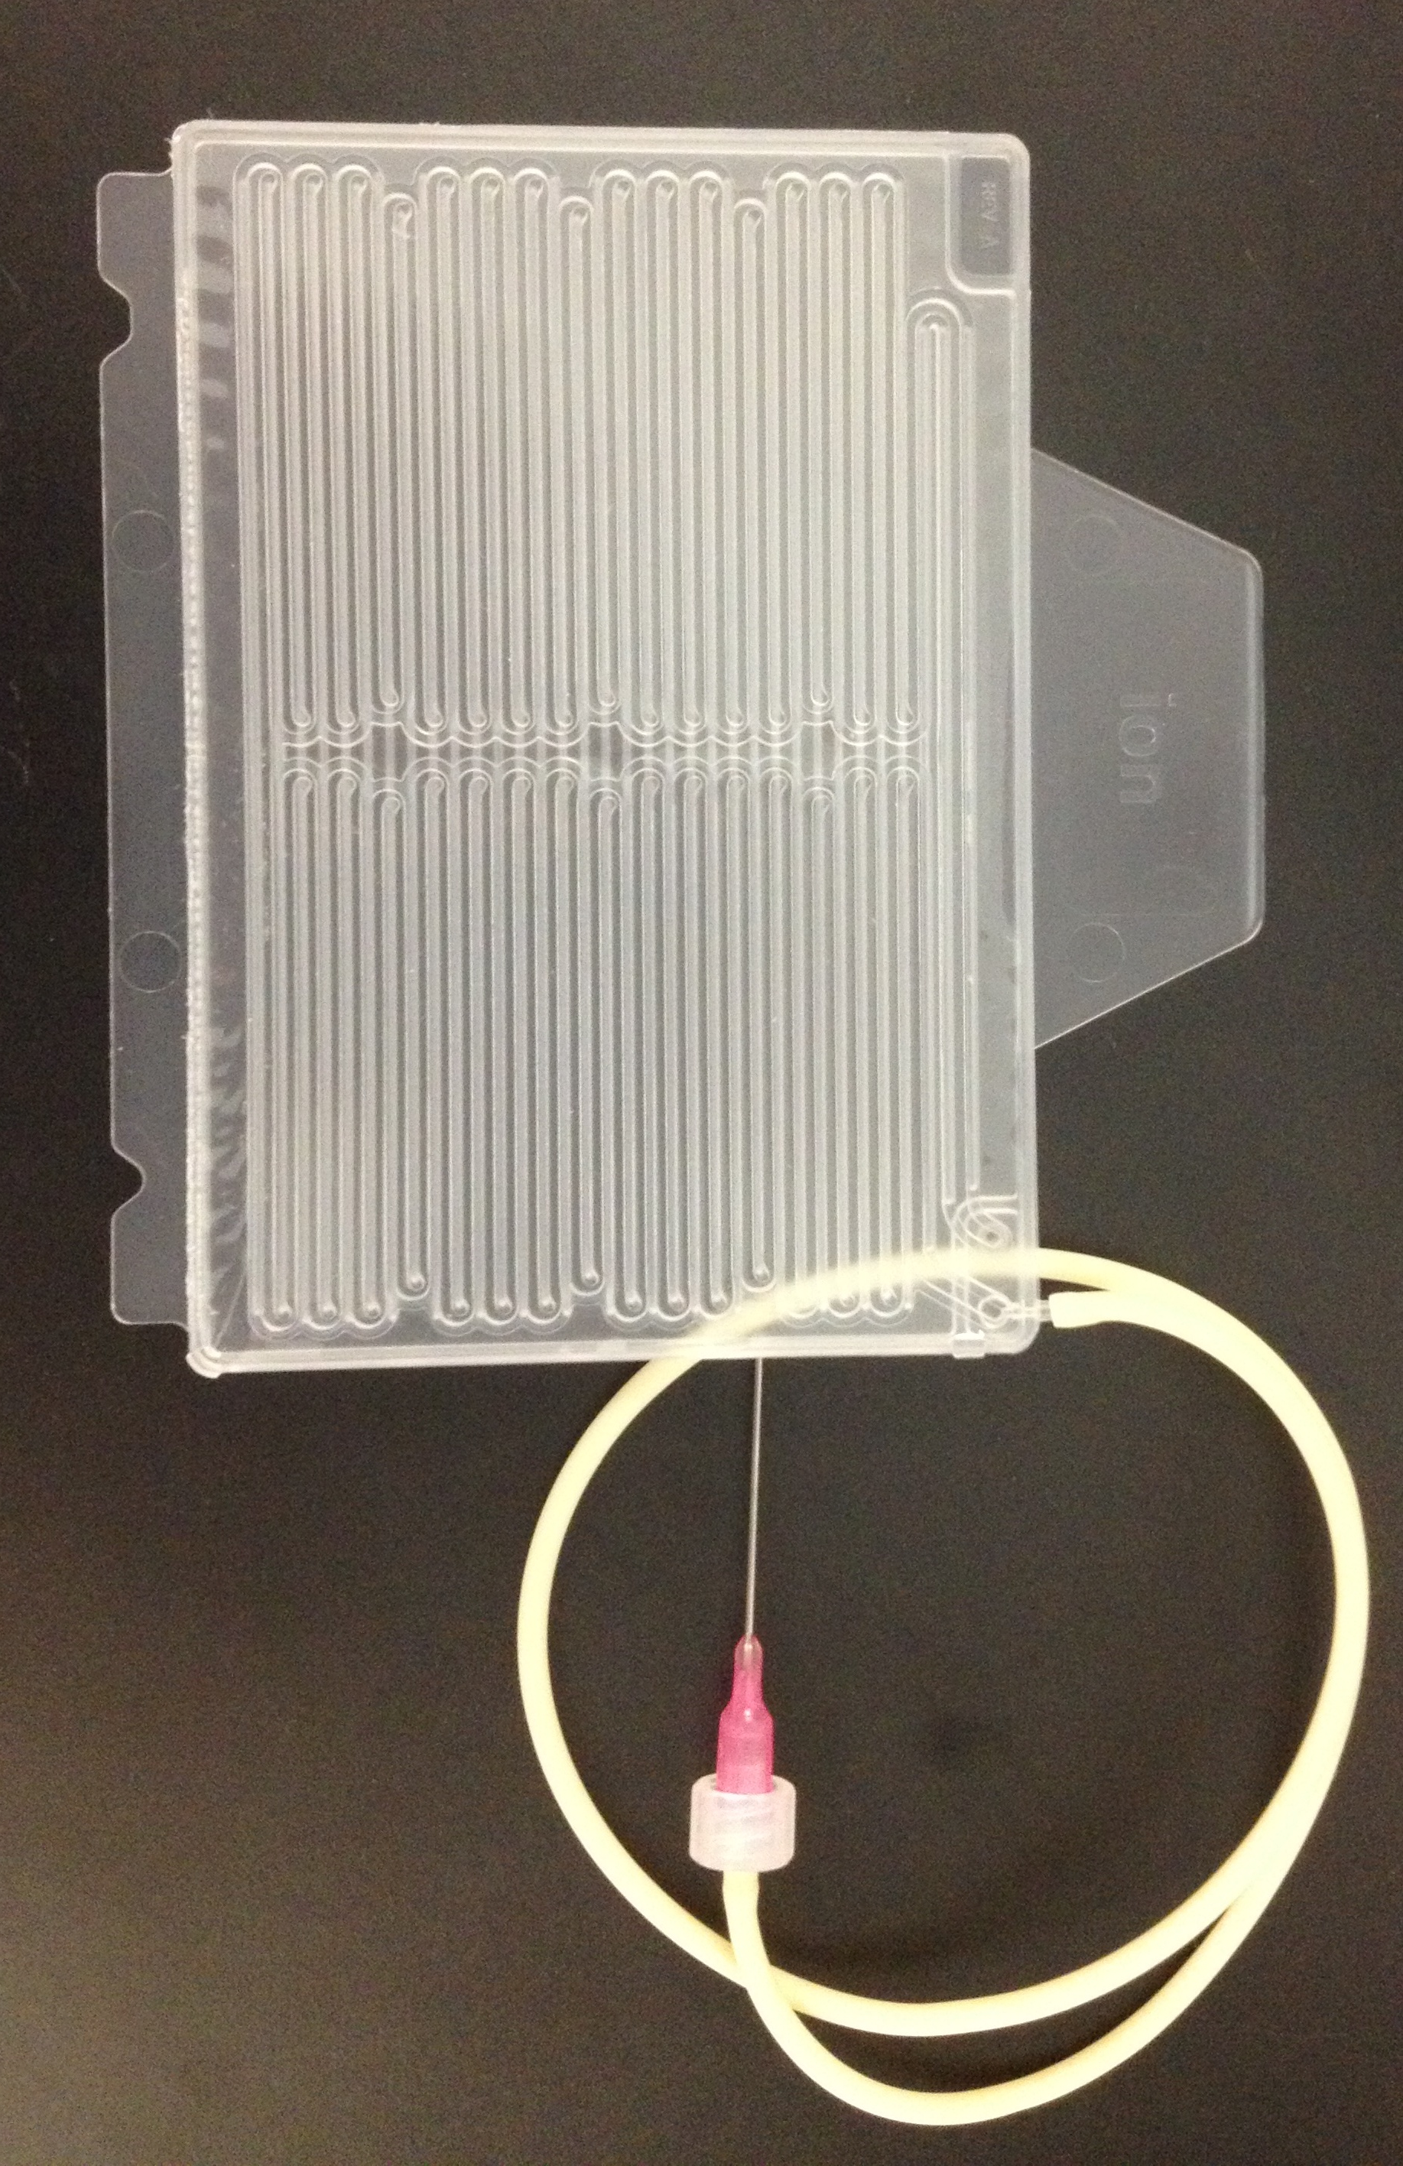
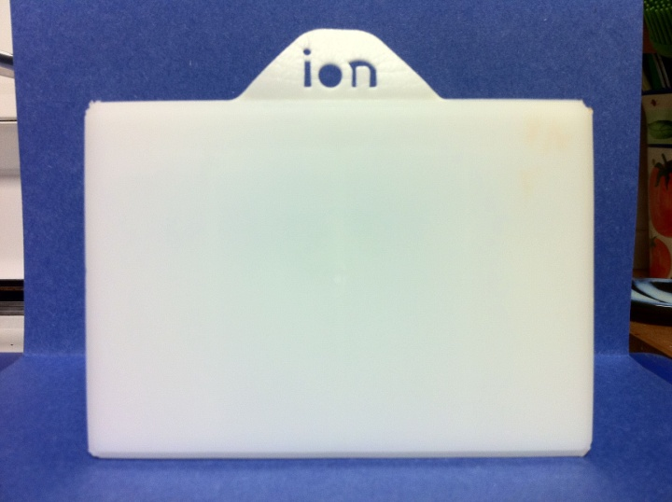
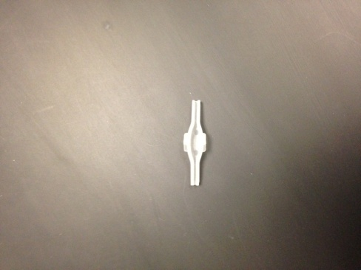
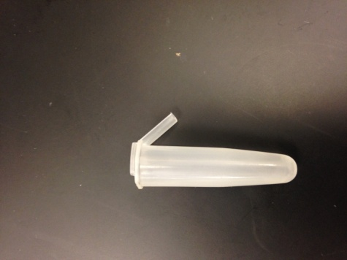
Ion OneTouch™ 2 Instrument Supplies
Ion OneTouch™
Reaction Filter Assembly
Amp Plate
Recovery Router
Recovery Tube
Notes:
Point these out and hand around in class

Slide 9
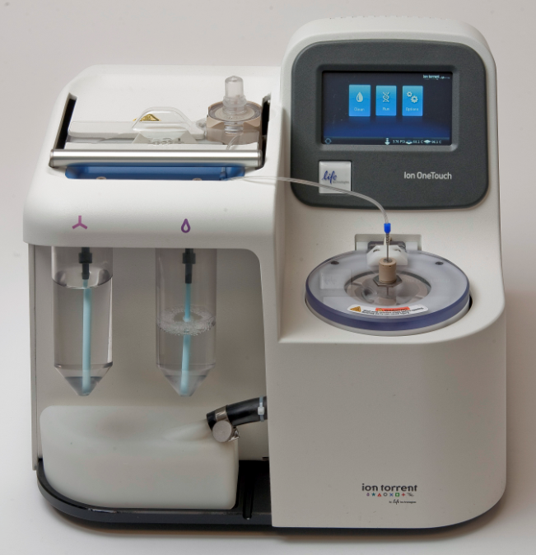

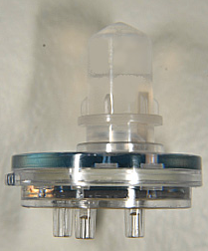
Ion OneTouch™ Instrument Workflow
Set-Up Instrument
with Supplies
and Solutions:
Add Filter Assembly and Begin Run
Set-Up
PCR Rxn
Pipette into
Filter
Assembly:
Notes:
Set up:
Load amp plate
Fill/load oil and recovery tubes
Empty waste
Prep centrifuge
Thread disposable tubing through pinch valve
Set up PCR:
Mix components, add to filter
Amplify:
Load Ion filter containing sample, amplification mix, and oil
Initiate run from touch screen

Slide 10
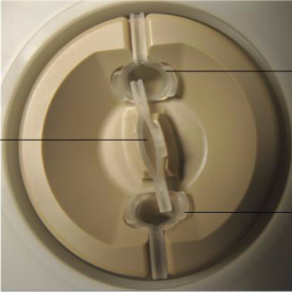
What happens next?
Emulsion
generation
.
PCR
Amplification
.
Emulsion
Breaking:
Oil removed
ISP
Recovery
Notes:
Show in the lab
Emulsion is formed: Oil and Amp reaction mix are pushed through reaction filter to generate microscopic reaction vesicles.
PCR Amplification: Vesicles are pushed into amplification plate, and undergoes PCR
3) Emulsion Breaking: Vesicles exit amp plate into centrifuge, where they are injected into recovery router, which routes vesicles into recovery tubes
4) ISP Recovery: Vesicles break in Recovery solution, and ISPs are recovered through centripetal force. Oil is siphoned off top of recovery tube into waste

Slide 11
Ion OneTouch™ ES Orientation
Touch pad
Mechanical Arm
Pipet Tip Loader
8-well strip tube
(flanked by magnets)

Slide 12
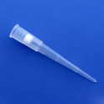
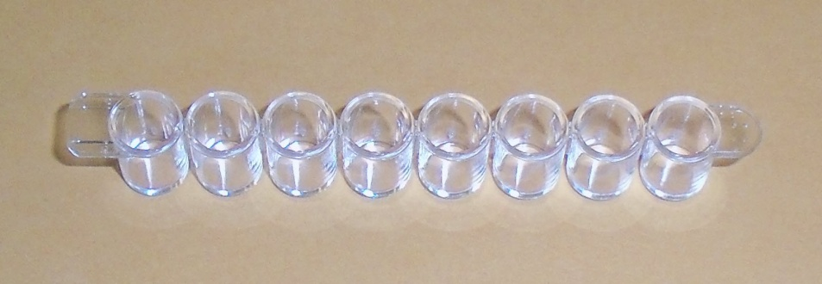

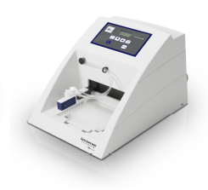
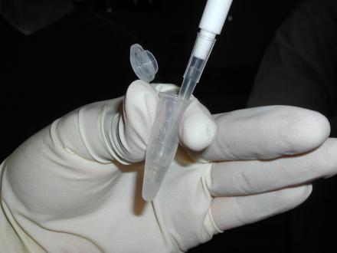
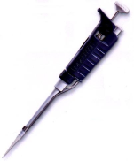
Ion OneTouch™ ES Workflow
Set-Up ES:
Supplies/Reagents
Start enrichment:
Retrieve
OneTouch2™
Sample:
Notes:
1.) Retrieve OneTouch2:
2.) SampleSet-Up ES:
Load reagents into 8-well strip
Position in ES
Attach liquid handling tip
Recover sample from Instrument
Remove recovery solution
Resuspend
3.) Start Enrichment

Slide 13

What happens next?
ES Automated Enrichment
Robotic arm moves 8-well strip on and off of magnet during magnetic purification steps
Biotinylated templated ISPs are purified from the rest of the sample.
1
2
3
4
5
6
7
8
ISP sample
MyOne™ Beads
Wash Solution
Wash Solution
Wash Solution
Empty
Melt-Off Solution
Empty
Notes:
Just introduce the idea of enrichment: details on next slide

Slide 14
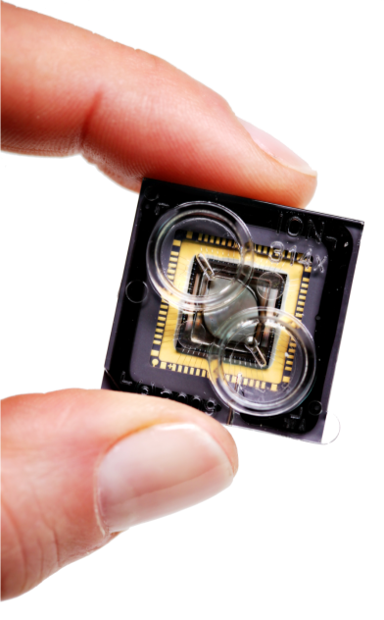
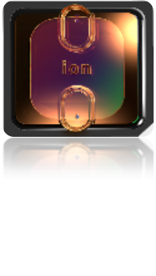
Ion Torrent™ : Semiconductor Sequencing for Life™
Support
Robert David
6178723352
Robert.David@thermofisher
ionsupport@lifetech.com
Call 800-955-6288 in USA
Bioinformatics support
ngs-amsupport@lifetech.com
Jingwei.Ni@thermofisher.com
Online info for Ion Torrent Systems Thermofisher Ion Community
The Chip is the Machine™
Notes:
PLEASE CHANGE TECH SUPPORT NUMBER TO MATCH YOUR REGION’S CONTACT INFORMATION – THIS IS US-ONLY

Slide 15

For Research Use Only. Not for use in diagnostic procedures.
Ion Torrent™ is a Thermo Fisher Scientific brand. © 2014 Thermo Fisher Scientific, Inc. All rights reserved. TaqMan is a registered trademark of Roche Molecular Systems, Inc., used under permission and license. All other trademarks are the property of Thermo Fisher Scientific and its subsidiaries.

